Slide 1
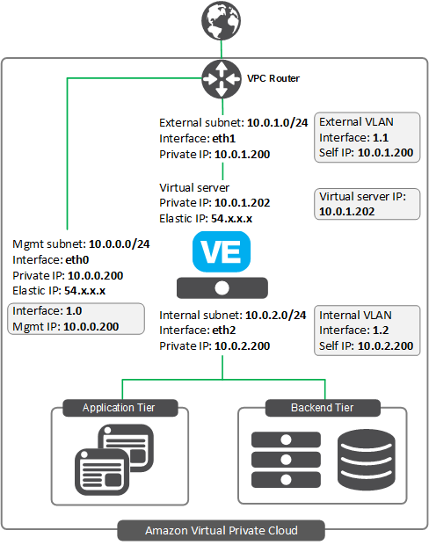
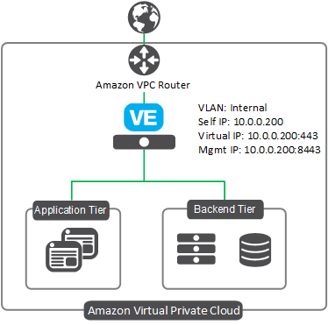
1-NIC BIG-IP VE Deployment on AWS
2-NIC BIG-IP VE Deployment on AWS
Manual Deployment ~ 3+ hours
Templated Deployment ~ 40 mins
Manual Deployment ~ 3+ hours
Templated Deployment ~ 40 mins

Slide 2
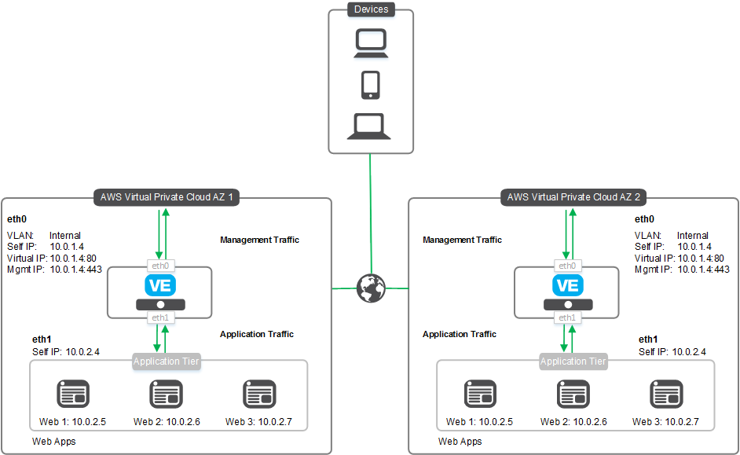
2 Clustered BIG-IP VE’s on AWS (Across AZ - 2NIC)
Manual Deployment ~ 8+ hours
Templated Deployment ~ 40 mins

Slide 3
Auto Scale WAF deployment on AWS via ELB
Manual Deployment ~ 7+ hours
Templated Deployment ~ 40 mins

